Slide 1
Adult Programs at
C.H. Booth Library
Presented to the
Library Board of Trustees
Saturday, April 3rd, 2010
Kimberley Weber
weberk4@southernct.edu
ILS 501-S70
Professor Hak Joon Kim
Notes:
Welcome
Introduction and thank you for taking the time to meet with me.
Brief bio information about myself and description of my duties at the library, especially important as there are 12 new board members join ing since the last time I made a presentation.

Slide 2

The library of 2010 is no longer just about the book.
Why Should We Spend Money on Programs?

Slide 3

CHB Crowd Favorites of 2009-2010
  Author talk with Steig Larsson
  Cooking class with Julia Childs
  Visit with the cast of Glee
  Production of The Birdcage with Nathan Lane
  Grateful Dead concert in the Backyard
  Independent Film Series with a sneak peek at Sundance Festival Nominees
  Comedy Night with Stephen Colbert and Jon Stewart
  Author Talk with Carlos Eire

Slide 4
Annual Number of Programs by Department
Notes:
Attendance has been steadily rising for children, young adult and adult programs, but most significantly for adult programs.
This is due in part to the summer concert series and the adult reading program which continues to attract new members to the library.
The huge jump in 2006 reflects the increased budget we received from the Friends of the Library.
Young Adult has increased dramatically and directly correlates to the hiring of the YA librarian.

Slide 5

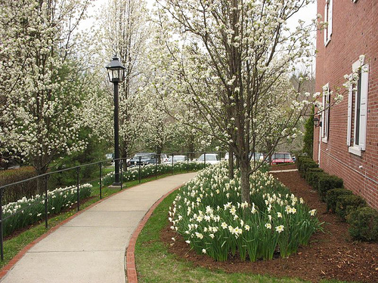
Continued Goals of Adult Library Programs
Enrich the community by providing quality programs.
Support local artists, authors, speakers and experts by inviting them to speak at the library and showcase their talents and knowledge.
Provide intergenerational programs to encourage family use of the library.
Foster idea of library as a community center with nontraditional programs such as art and music classes.

Slide 6
What can you do at the library besides check out the latest best seller?
Join us for a variety of interesting programs.

Slide 7

Marketing Strategies in 2010-2011
.
Increase use of social media: blogging, FaceBook,
and Twitter
plus outreach by visiting civic groups and schools.
Notes:
CHBooth does need to improve it’s marketing campaign.
We lag behind other Connecticut libraries in our use of social media.
With our use of E-blasts through Constant Contact we saw an upsurge of program signups.
Coupled with LibraryInsight, Constant Contact is responsible for a 75% increase in attendance.

Slide 8
Current Revenue Sources for Programs
51%
Notes:
Clearly we need to be more aggressive in applying for grant money especially as the town’s support of the library has remained flat for the last three years. We currently don’t have anyone on staff with time to write these time consuming documents, but in the year to come we will need to find someone. Possibly outsource? Ask for suggestions?
There is also a good chance that the Friends will see a decline in giving as the book sale begins to see a drop in both donations and sales.
The budget we’ll be voting on in a few weeks shows a decrease in town support.

Slide 9
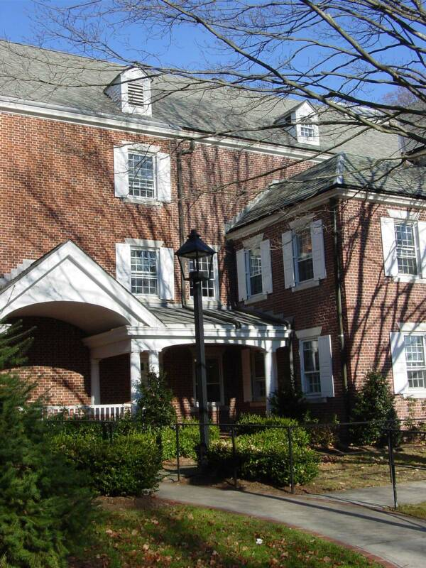
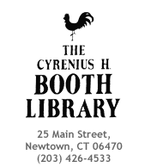
See what's going on right now at CH Booth
You can get a complete list of all upcoming programs at the library today and every day.
Sign up online for :
  Programs
  Wowbrary
  E-blasts
  Twitter alerts
  To become a fan on Facebook.

Slide 10
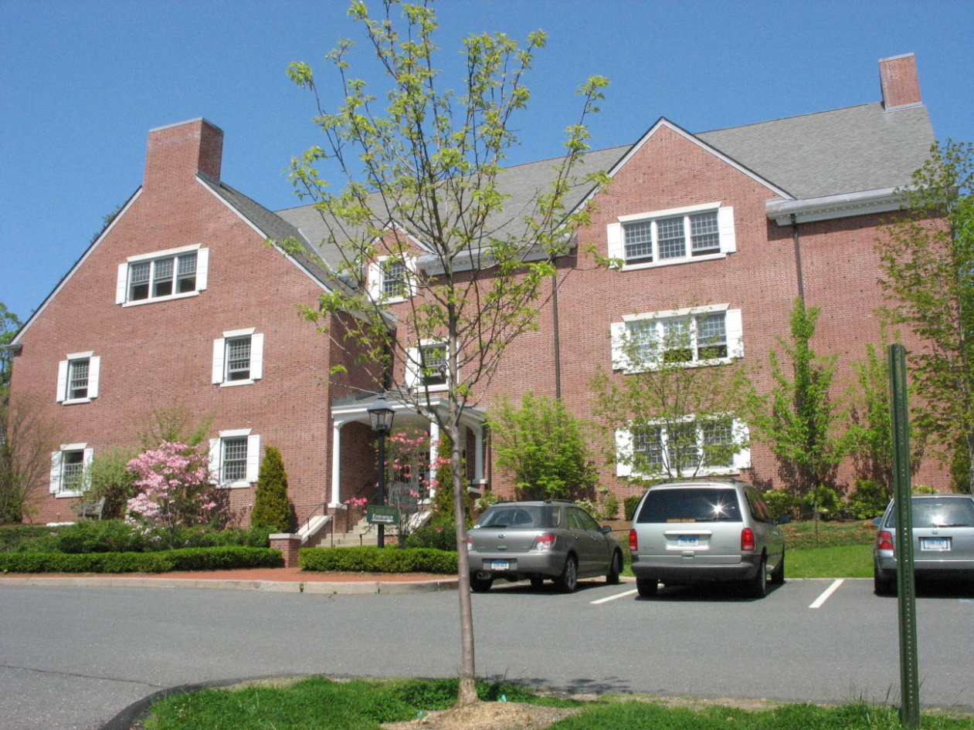
The Cyrenius H. Booth Library Today
How do we get new patrons in the door?
And keep them coming back?
Notes:
This is the time to brain storm with the Board.
What are we doing well?
Where do we need to improve?
What suggestions do they have for future programs?

