Slide 1
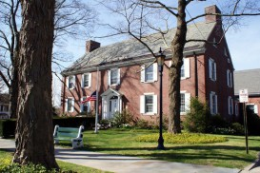
CH Booth Library User Satisfaction Survey
March 2013

Slide 2
Methodology
WHAT: | A Cyrenius H. Booth Library customer satisfaction survey conducted via online interviewing of current library users.
WHO: | A total of 430 users aged 18 and over
HOW: | Myriad approaches to invite respondents: Survey link posted on website for any viewer to take Invites sent to all Constant Contact subscribers Bookmarks to all patrons checking out books Fliers in-house Newtown Bee
LENGTH: | Average of 7 ½ minutes
WHEN: | February 4-20, 2013

Slide 3
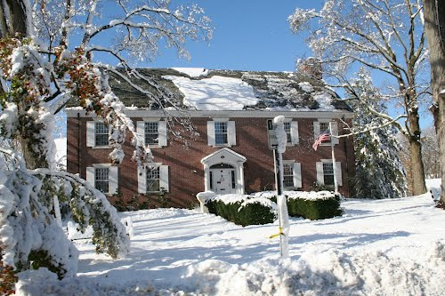
Detailed Findings

Slide 4
Many Visitors Are True "Regulars"
Frequency of Visiting the Library?
Total (n=430)
Over a third visit at least once a week!
Q. How often do you visit the CH Booth Library?

Slide 5
Why Less Often? Finding Items Elsewhere
Reasons Why Don’t Visit More Frequently?
(n=283)
Frequency of Visiting
Total (n=430)
I buy my own books and magazines
It doesn’t have the materials I need
I use my school/college library
I use a neighboring public library
Too busy/not enough time
I get content for e-readers remotely
I don’t know what the library has to offer me
I use the town library near where I work
Why Not More?
Q: If you don’t use the library regularly, why not?

Slide 6
Borrowing Clearly Drives Visits . . .
Reasons for Visiting the Library
(n=430)
To borrow fiction books (non best-sellers)
To borrow DVDs
To borrow nonfiction books
To borrow best sellers
To attend meetings/programs
To borrow books on CD
To use the children's area
To get information/research
To use the internet/wi-fi
To use reference materials
To attend children's programs
To find a quiet place to work
Books!
Q: I have taken advantage of the following services at the library.
Q. What are the top three reasons you visit the library?

Slide 7
. . . But Many Other Secondary Reasons to Come to CHB
Reasons for Visiting the Library
(n=430)
To read/borrow magazines
To use the copy machine
To use the young adult area
To get information for a school project
To meet friends/business associates
To read newspapers
To borrow museum passes
To get income tax forms
To use word processing computers
To attend teen programs
To use business resources
To do job searches/databases
To use the public fax
Q: I have taken advantage of the following services at the library.
Q. What are the top three reasons you visit the library?

Slide 8
We Need More Materials
Reasons Didn’t Find What Looking For
(n=71)
Find What You Were Looking
For on Last Visit?
Total (n=427)
Library did not own what I needed
Item was checked out
I could not find the material
I could not find item on shelf
Staff requested material through interlibrary loan
Staff could not find material
Other
Why Did Not Get What Looking For?
Q: Think back to the last time you visited the library. Did you find what you were looking for?
Q: What are the reasons why you didn’t find what you were looking for?

Slide 9
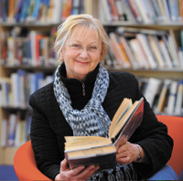
Overall High Satisfaction
Overall Rating
Total (n=427)
Virtually all are satisfied!
Q: Overall, how would you rate the CH Booth library?

Slide 10
Courtesy and Desire to Help of Paramount Importance
Importance of Library Aspects
(n=427)
Willingness to help customers
Employees are courteous
Provide services as promised
Employees have the knowledge to answer customer questions
Dependable in answering customer questions
Readiness to respond to customer questions
Employees deal with customers in a caring fashion
Employees understand customer needs
Convenient library hours
Have the best interest of the customer
Q: For the next question, we'd like you to rate the importance of certain customer service aspects of the Cyrenius Booth library, on a scale of extremely important to not at all important

Slide 11
Technology Also a Strong Need; Appearance Less So
Importance of Library Aspects
(n=427)
Prompt service to customers
Up to date technology
Perform services right the first time
Transactions are accurate and confidential
Give customers individual attention
Keeps customers informed about when services will be performed
Employees instill confidence in customers
Visually appealing facilities
Employees have neat and professional appearance
Q: For the next question, we'd like you to rate the importance of certain customer service aspects of the Cyrenius Booth library, on a scale of extremely important to not at all important

Slide 12
Service Satisfaction Levels Very High – Especially on Being Courteous
Satisfaction Rating of
Library Aspects
(n=427)
Willingness to help customers
Provide services as promised
Employees are courteous
Readiness to respond to customer questions
Employees deal with customers in a caring fashion
Have the best interest of the customer
Dependable in answering customer questions
Give customers individual attention
Employees have the knowledge to answer customer questions
Perform services right the first time
Q: Now please rate the Cyrenius Booth library itself on these same customer service aspects using the following scale of excellent to poor. Even if you have not experienced one of these situations, answer based on what your expectations would be

Slide 13
Relatively Low Perception of Latest Technology
Satisfaction Rating of
Library Aspects
(n=427)
Employees have neat and professional appearance
Transactions are accurate and confidential
Prompt service to customers
Visually appealing facilities
Employees understand customer needs
Keeps customers informed about when services will be performed
Employees instill confidence in customers
Convenient library hours
Up to date technology
Q: Now please rate the Cyrenius Booth library itself on these same customer service aspects using the following scale of excellent to poor. Even if you have not experienced one of these situations, answer based on what your expectations would be

Slide 14
Perceived Gaps in Technology and Hours
Gap (Imp. Higher than Rating)
Conv. Hours

Slide 15
Virtually All Will Recommend CH Booth
Recommend to a Friend?
Total (n=427)
Q: Would you recommend us to a friend?

Slide 16
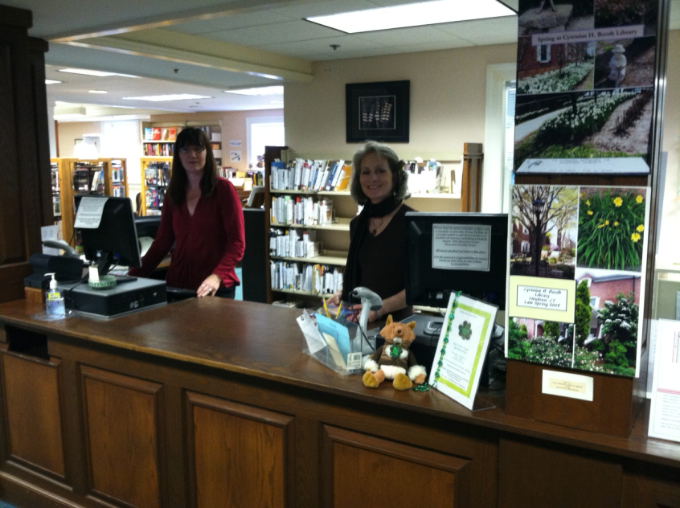
Comments on Our Staff – a Sampling
“Service is always done
with a smile.”
“A library is more than a building with books or computers. The librarians and staff members at the Booth Library are always ready with reading suggestions. They create displays of books that inspire me to try new authors and help me find information I need--even when they have to order books from other libraries or call around to get an answer to a question. This staff is the best!”
‘I always leave there with a happy feeling.”
“Excellent customer service, professional, knowledgeable, friendly!! Amazing resource as well.”
“I like that employees remember my face (not necessarily my name) and are friendly to me”
“The library has always provided me with excellent service whether it be answers to questions on reference material or answers to general questions on availability of books. The staff is knowledgeable and congenial. The staff is doing everything possible to make visiting the library an enjoyable experience.”
“After living in several towns and using their libraries extensively, I can proudly say that "we have a GREAT library!"
“I couldn’t ask for a friendlier staff. The staff is THE essential part of my visit”
.

Slide 17
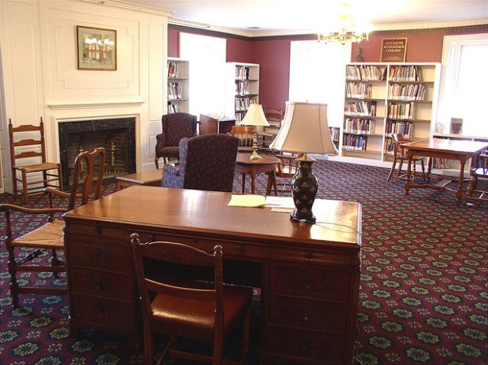
Comments on the library in general - a Sampling
“The Booth Library is like a library out of a children’s book – inviting, caring, warm & welcoming. It also has great books, and is a wonderful resource as to what is going on in town.”
“I love Booth library! It is located centrally, in town, and motivates me to continue visiting.
“Going to the library is comfortable. It’s like going to someone’s home. Nice staff and atmosphere.”
‘It’s a wonderful asset of the town.”
“The CH Booth Library is a warm and friendly place to visit. Everyone can use that kind of TLC.”
“After living in several towns and using their libraries extensively, I can proudly say that "we have a GREAT library!"
“CH Booth Library is one of the most attractive libraries I have ever visited. I often bring out of town guests to see it. In fact, the library is one of the reasons we chose Newtown over other neighboring communities when we chose to move here.”
“We have taken our grandchildren to your library and they love it! Everyone has been awesome to them, even when they forget it’s a library. ☺”
.

Slide 18
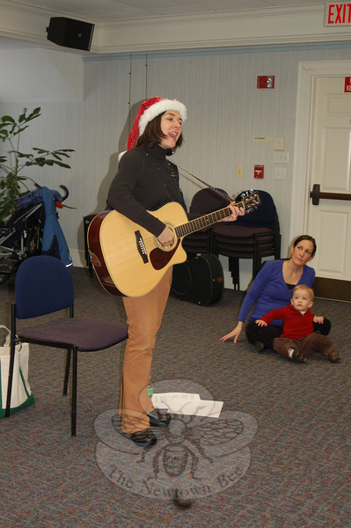
Comments on Programs – a Sampling
“LOVE the library. Love the changing exhibits, especially when they highlight a local artist.”
“I love the meetings and miss them when I’m not able to attend. I have told my friends about the book discussion groups and the Genealogy Club”
“The planned evening programs are interesting, covering a wide range of topics.”
“…it organizes excellent children’s and adult programs which my family enjoys attending.”
“Best story hours in Connecticut. Mother Goose, she’s a hoot!”
“We love the children’s programs.”
“Love the library now more than ever. It has become a center for the community in the aftermath of 12/14 with caring and support for all ages.”
“I love the summer reading programs for the kids. There is something fun to do almost every day of the week and it’s free. I wish more people realized just how much there is to do at the library ”
.

Slide 19
Comments from the very few dissatisfied . . .
Remember - -
less than 2%!
“The technology to borrow e-books should be more user friendly.”
“Often I don’t find the books I’m looking for in Newtown, but I do find them in Bethel. It is also frustrating to find “new” books in the new section that were published several years ago.”
“The media department (movies and music) does not compare with the more high-end libraries like Westport Public Library.”
“Not up to date.”
“Not enough good lighting or places to work quietly.”
“I would love to see more programs for kids eight plus.”
“Not fully staffed with knowledgeable employees, reference materials are not fully up-to-date.
“(Southbury) their book quality is better, with cleaner covers and newer issues. We were once shushed when we visited the children’s department in Newtown.”
“…limited resources“

Slide 20
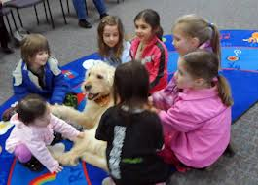
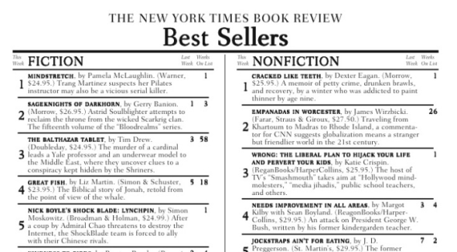
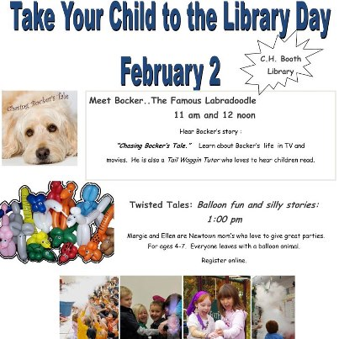
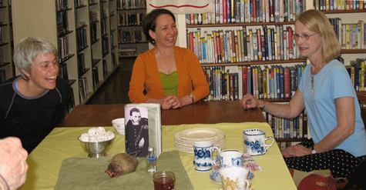
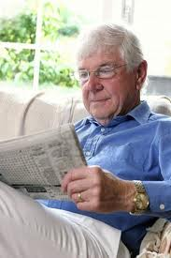
A Gender Gap Does Exist
Women Significantly
More Likely To…
Borrow best sellers
Borrow other fiction books
Get information for a school project
Use the children’s area
Attend meetings/programs
Bring children to the library
Men Significantly
More Likely To…
Read newspapers

Slide 21
Demographic Profile of Sample
Gender
Age
Education
18-39
40-49
HS / Voc Tech
50-59
Some College
60-69
20%
College Graduate
70 +
Graduate School
Average Age: 37.1 years old

Slide 22
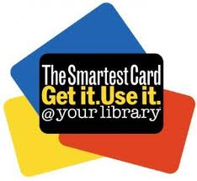
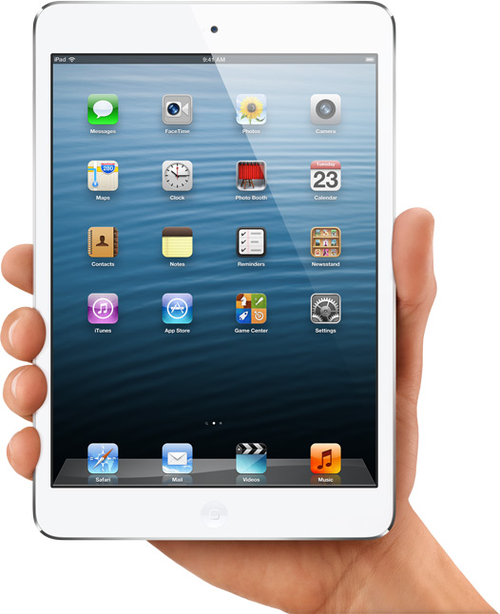
SUMMARY & IMPLICATIONS

Slide 23
Our Patrons LOVE Us . . .
EXTREMELY HIGH SATISFACTION WITH THE CYRENIUS H. BOOTH LIBRARY!
. . . AND THE MORE FREQUENT USERS LOVE THE LIBRARY MOST OF ALL.
LIBRARY STAFF – BIGGEST REASON FOR CUSTOMER SATISFACTION.
PROGRAMMING – ATTRACTS LIBRARY USERS WHO ARE NEW TO THE LIBRARY OR RETURNING AFTER TIME AWAY.
AS ALWAYS – MORE POPULAR TITLES ARE DESIRED.

Slide 24
….but HOW Do we Improve Technology Perception
SOME THOUGHTS…
ELECTRONIC MESSAGE BOARD
MORE STORIES IN THE NEWTOWN BEE
GREATER TECHNOLOGY PRESENCE ON 1st & 2nd FLOOR
EBLASTS WITH TECH NEWS
CONTINUED EMAIL COLLECTION AT CHECKOUT
SMART PHONE APPS
MORE SIGNAGE PROMOTING WI-FI

Slide 25
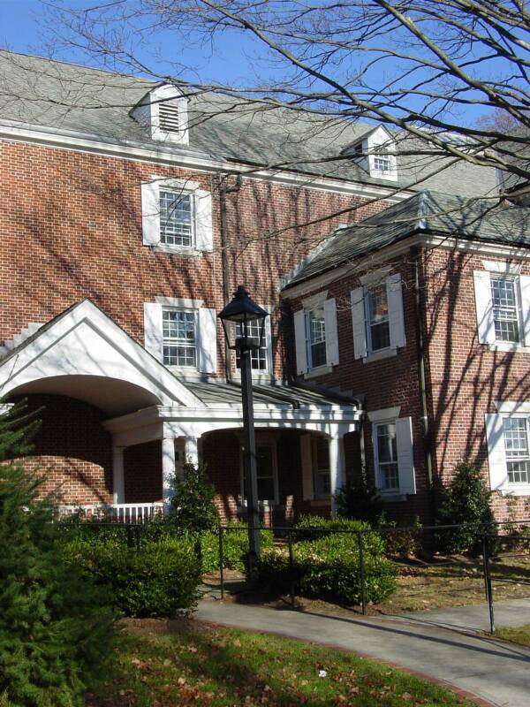
Thank you.

